Slide 1
PROJECT ON
Spam/ham email classification using nlp.
By:
name : Kizhakkeppattu Rahul Govindkumar
Email : krahulgovind@gmail.com

Slide 2
Problem statement/objectives
The objective of this project is :
To create and train such a ML Model which can tell us based on the contents of a message whether that message is a spam or ham
To create a website based on this ML model which is user-friendly and to successfully host the website on to the internet

Slide 3
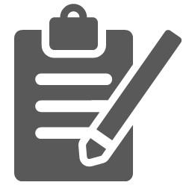

TABLE OF CONTENT
INTRODUCTION
STAGES OF OUR MODEL CREATION
VECTORIZATION
PREPROCESSING TECHNIQUES
DATA VISUALIZATION
MODEL TRAINING
MODEL ACCURACY AND ITS VISUALIZATION
SPAM CHECKER WEBSITE
WEBSITE OUTPUTS
CONCLUSION

Slide 4

INTRODUCTION
What is Spam ?
Spam is any kind of unwanted, unsolicited digital communication that gets sent out in bulk. Often spam is sent via email, but it can also be distributed via text messages, phone calls, or social media.
What is NLP?
Natural language processing (NLP) is the ability of a computer program to understand human language as it is spoken and written -- referred to as natural language. It is a component of artificial intelligence. NLP enables computers to understand natural language as humans do.

Slide 5
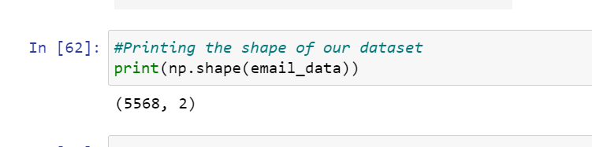
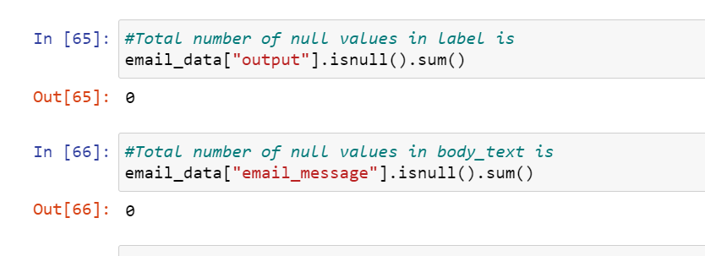
Stages of our model creation
In this project we are going to use the dataset called SMSSpamCollection.tsv
First we import all the required modules and then upload our dataset using the read_csv method of pandas
Then we analyse and further explore our dataset like finding total row and column number of the dataset , finding the number of null values in the dataset , etc
Then we move onto the next stage which is pre-processing of our data set before training the model
Then we vectorize our dataset , in this project we are using the TfidfVectorizer
Then we train our model , here in this project we are using the Random Forest Classifier
Then we check the accuracy of our model and then finally make predictions using that model

Slide 6
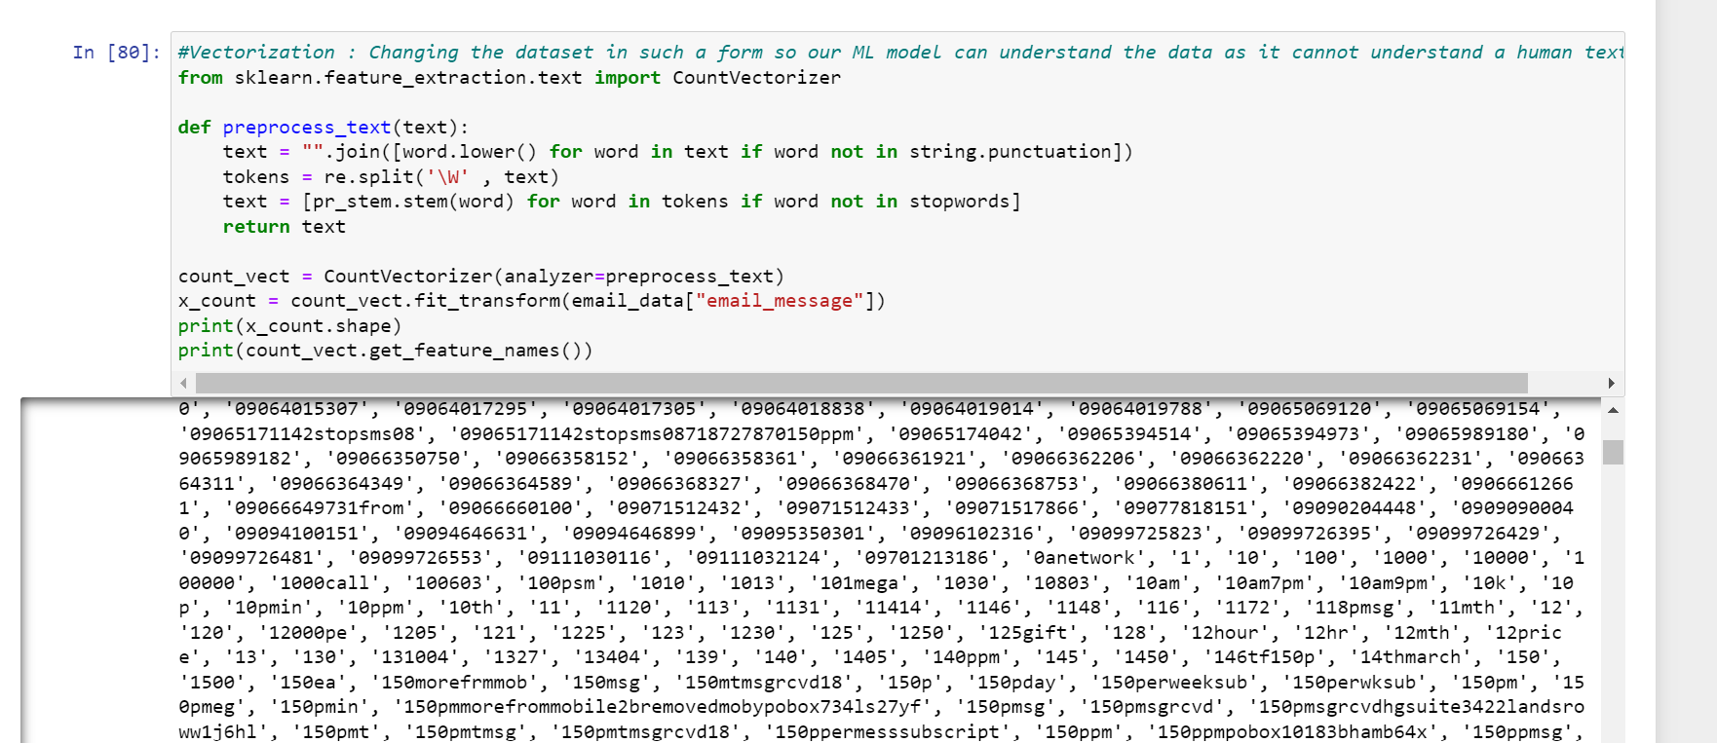
Vectorization

Slide 7
Preprocessing Techinques Used :
Remove punctuations : Here we remove all the unnecessary punctuations from our dataset
Tokenization : Tokenization is breaking the raw text into small chunks. Tokenization breaks the raw text into words, sentences called tokens.
Removing stopwords : Stop words are a set of commonly used words in any language. For example, in English, “the”, “is” and “and”, would easily qualify as stop words. In NLP and text mining applications, stop words are used to eliminate unimportant words, allowing applications to focus on the important words instead.
Stemming : Stemming is the process of reducing a word to its word stem that affixes to suffixes and prefixes or to the roots of words known as a lemma.
Lemmatization : lemmatization is a technique that switches any kind of a word to its base root mode.

Slide 8
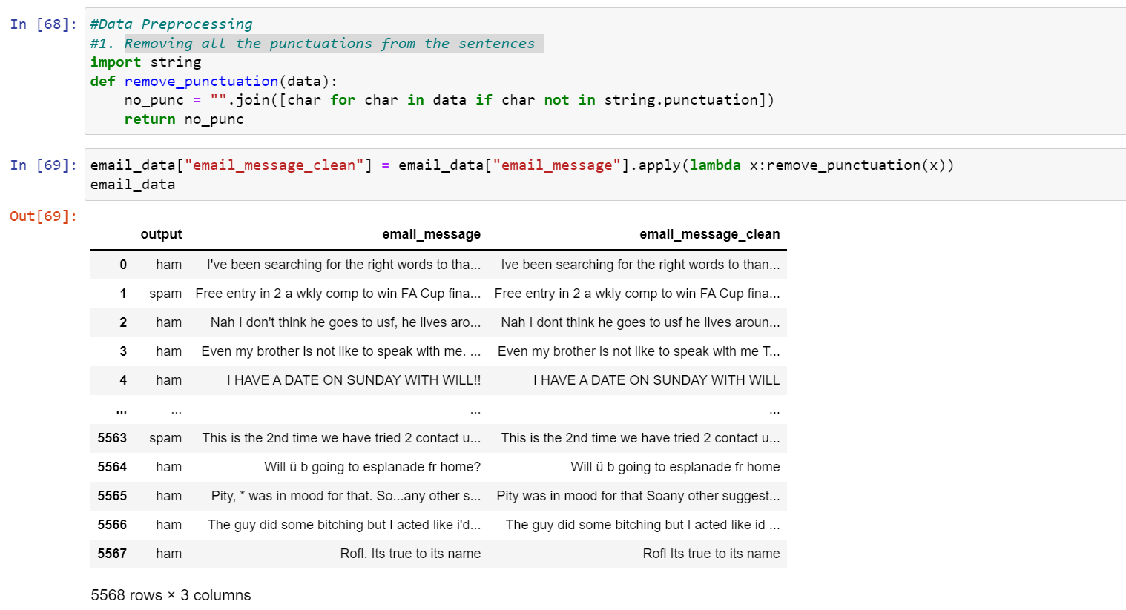
Remove Punctuations

Slide 9
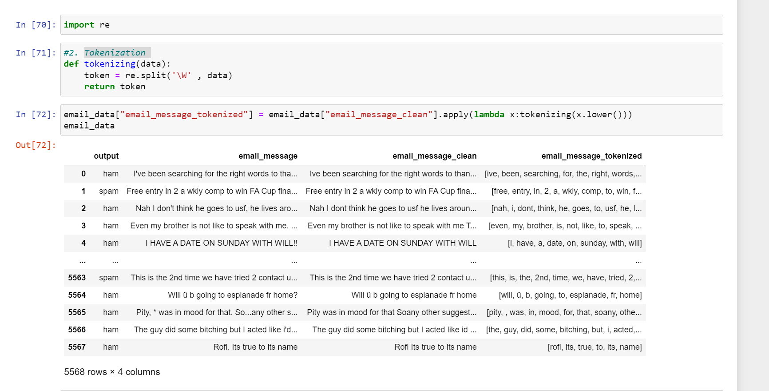
Tokenization

Slide 10
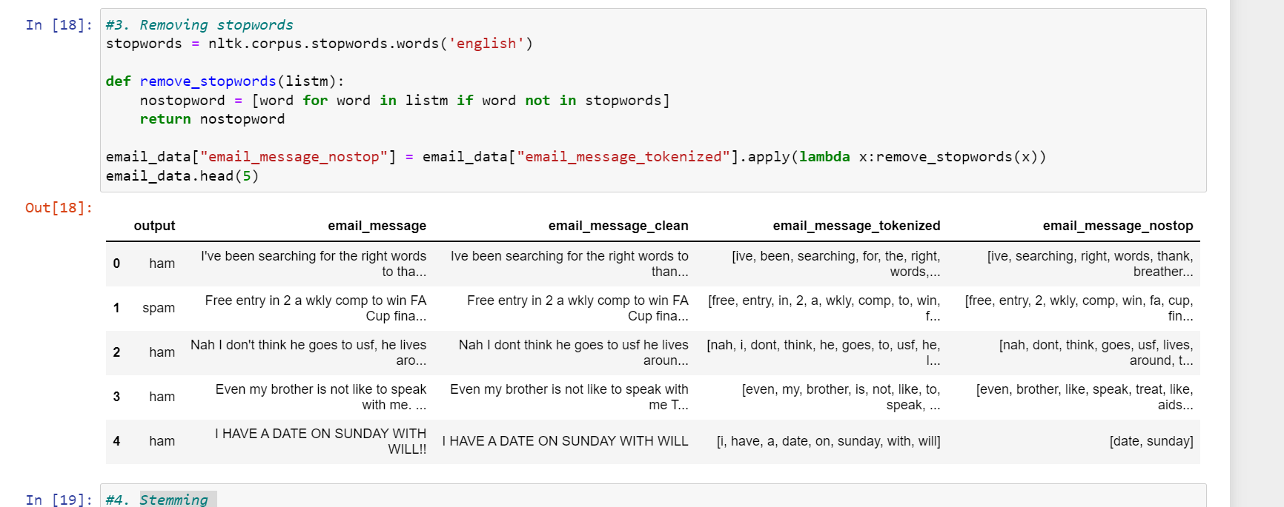
Removing stopwords

Slide 11
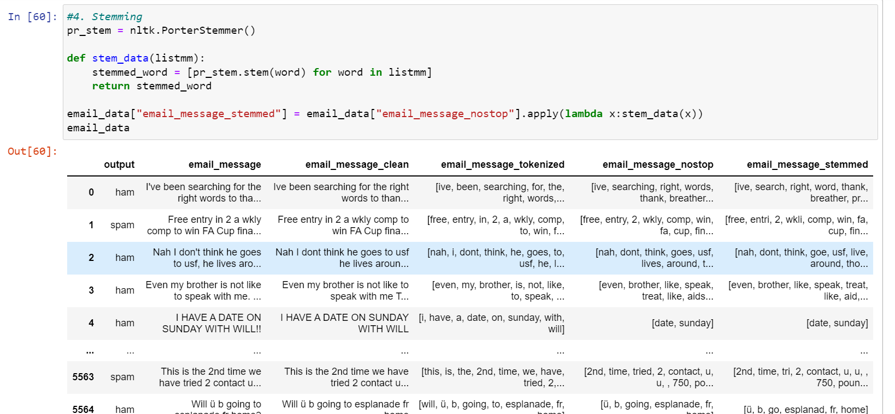
stemming

Slide 12
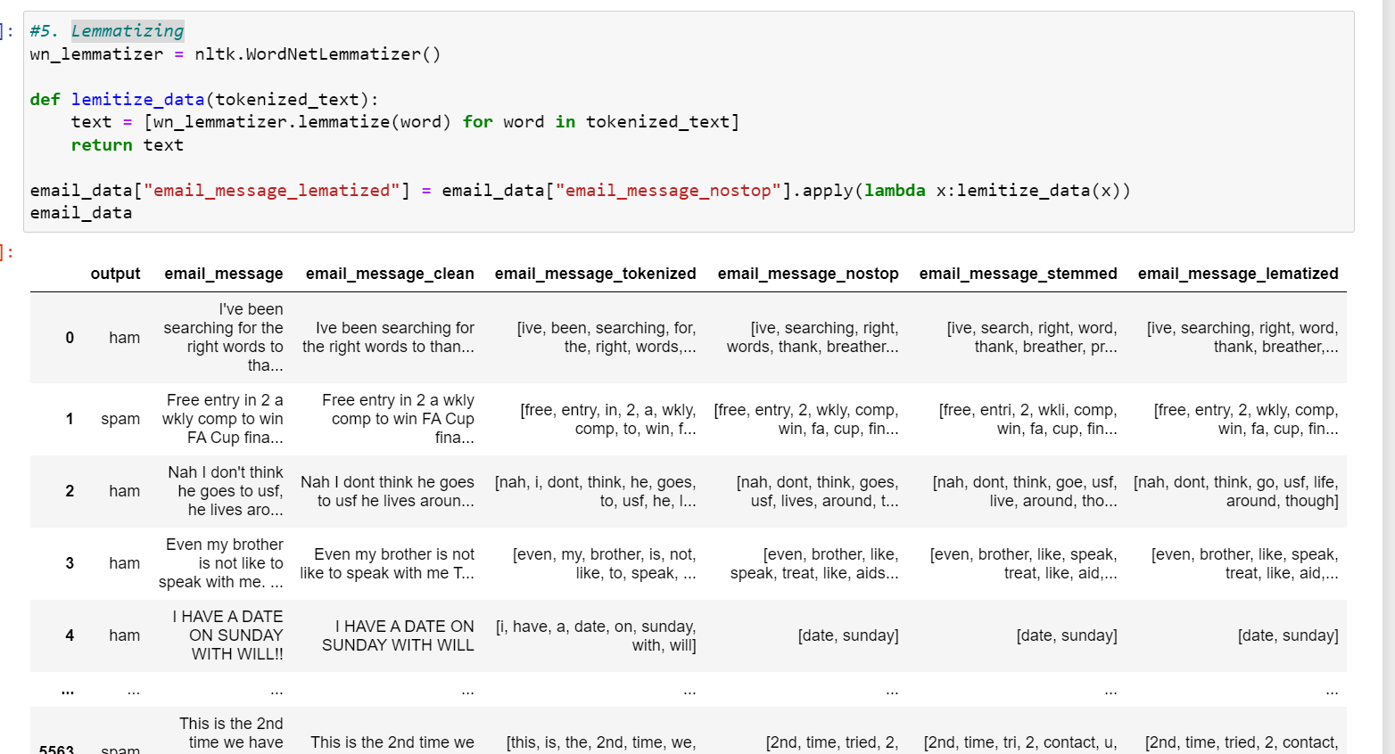
lematization

Slide 13
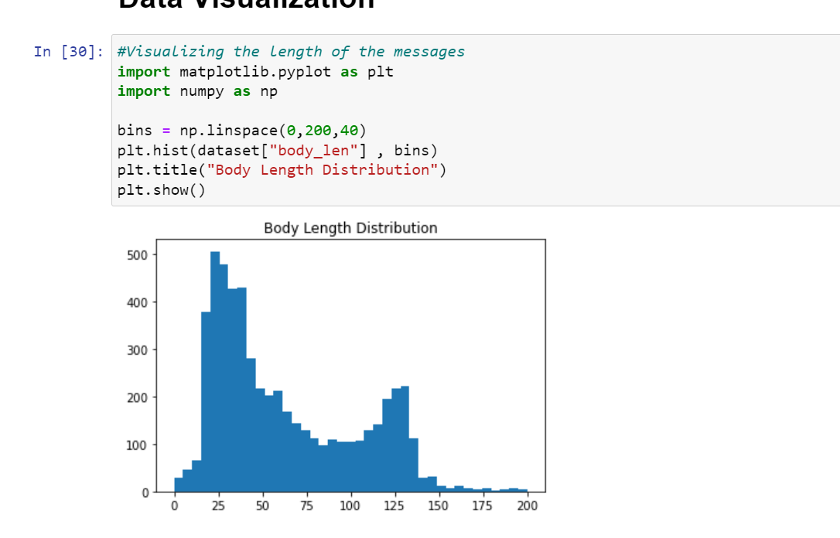
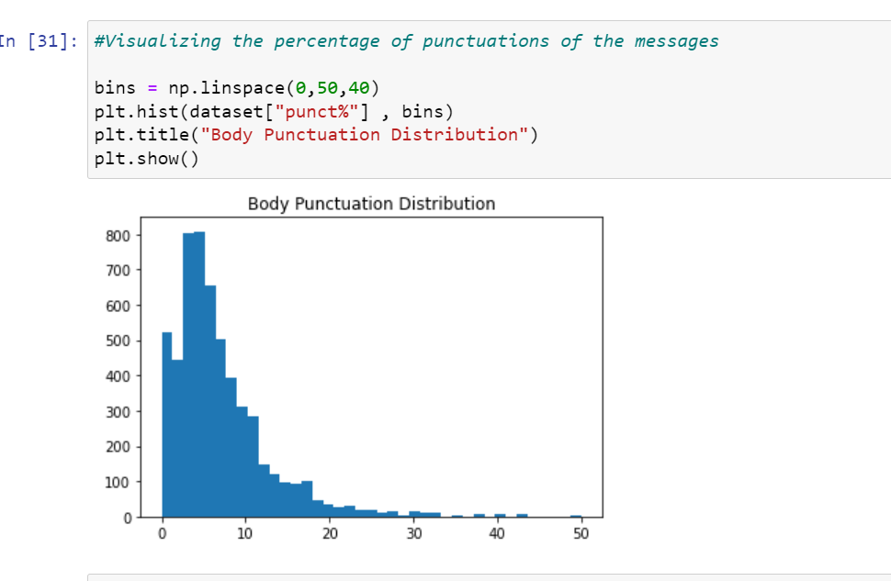
DATA VISUALIZATION

Slide 14
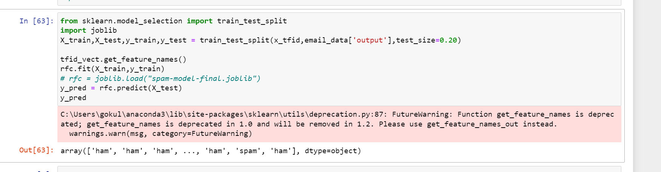
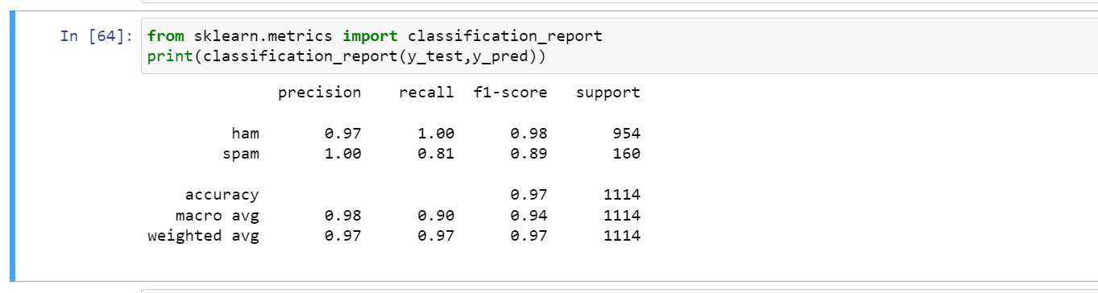
MODEL TRAINING

Slide 15
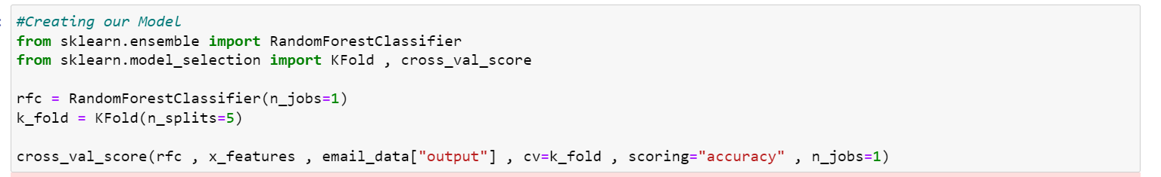
MODEL ACCURACY

Slide 16
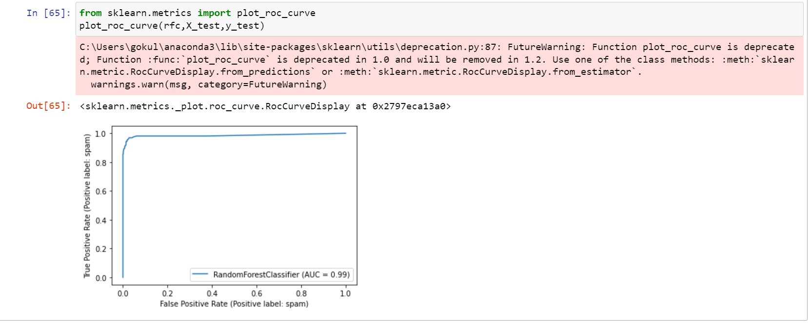
MODEL ACCURACY VISUALIZATION

Slide 17
OUR SPAMCHECKER WEBSITE
In this website we have used the model that we just created so that the user can interact with the model through this hosted website in a user friendly manner
In this website we have used : HTML , CSS , Javascript , Python , Flask , SQLAlchemy , Heroku for deployment

Slide 18
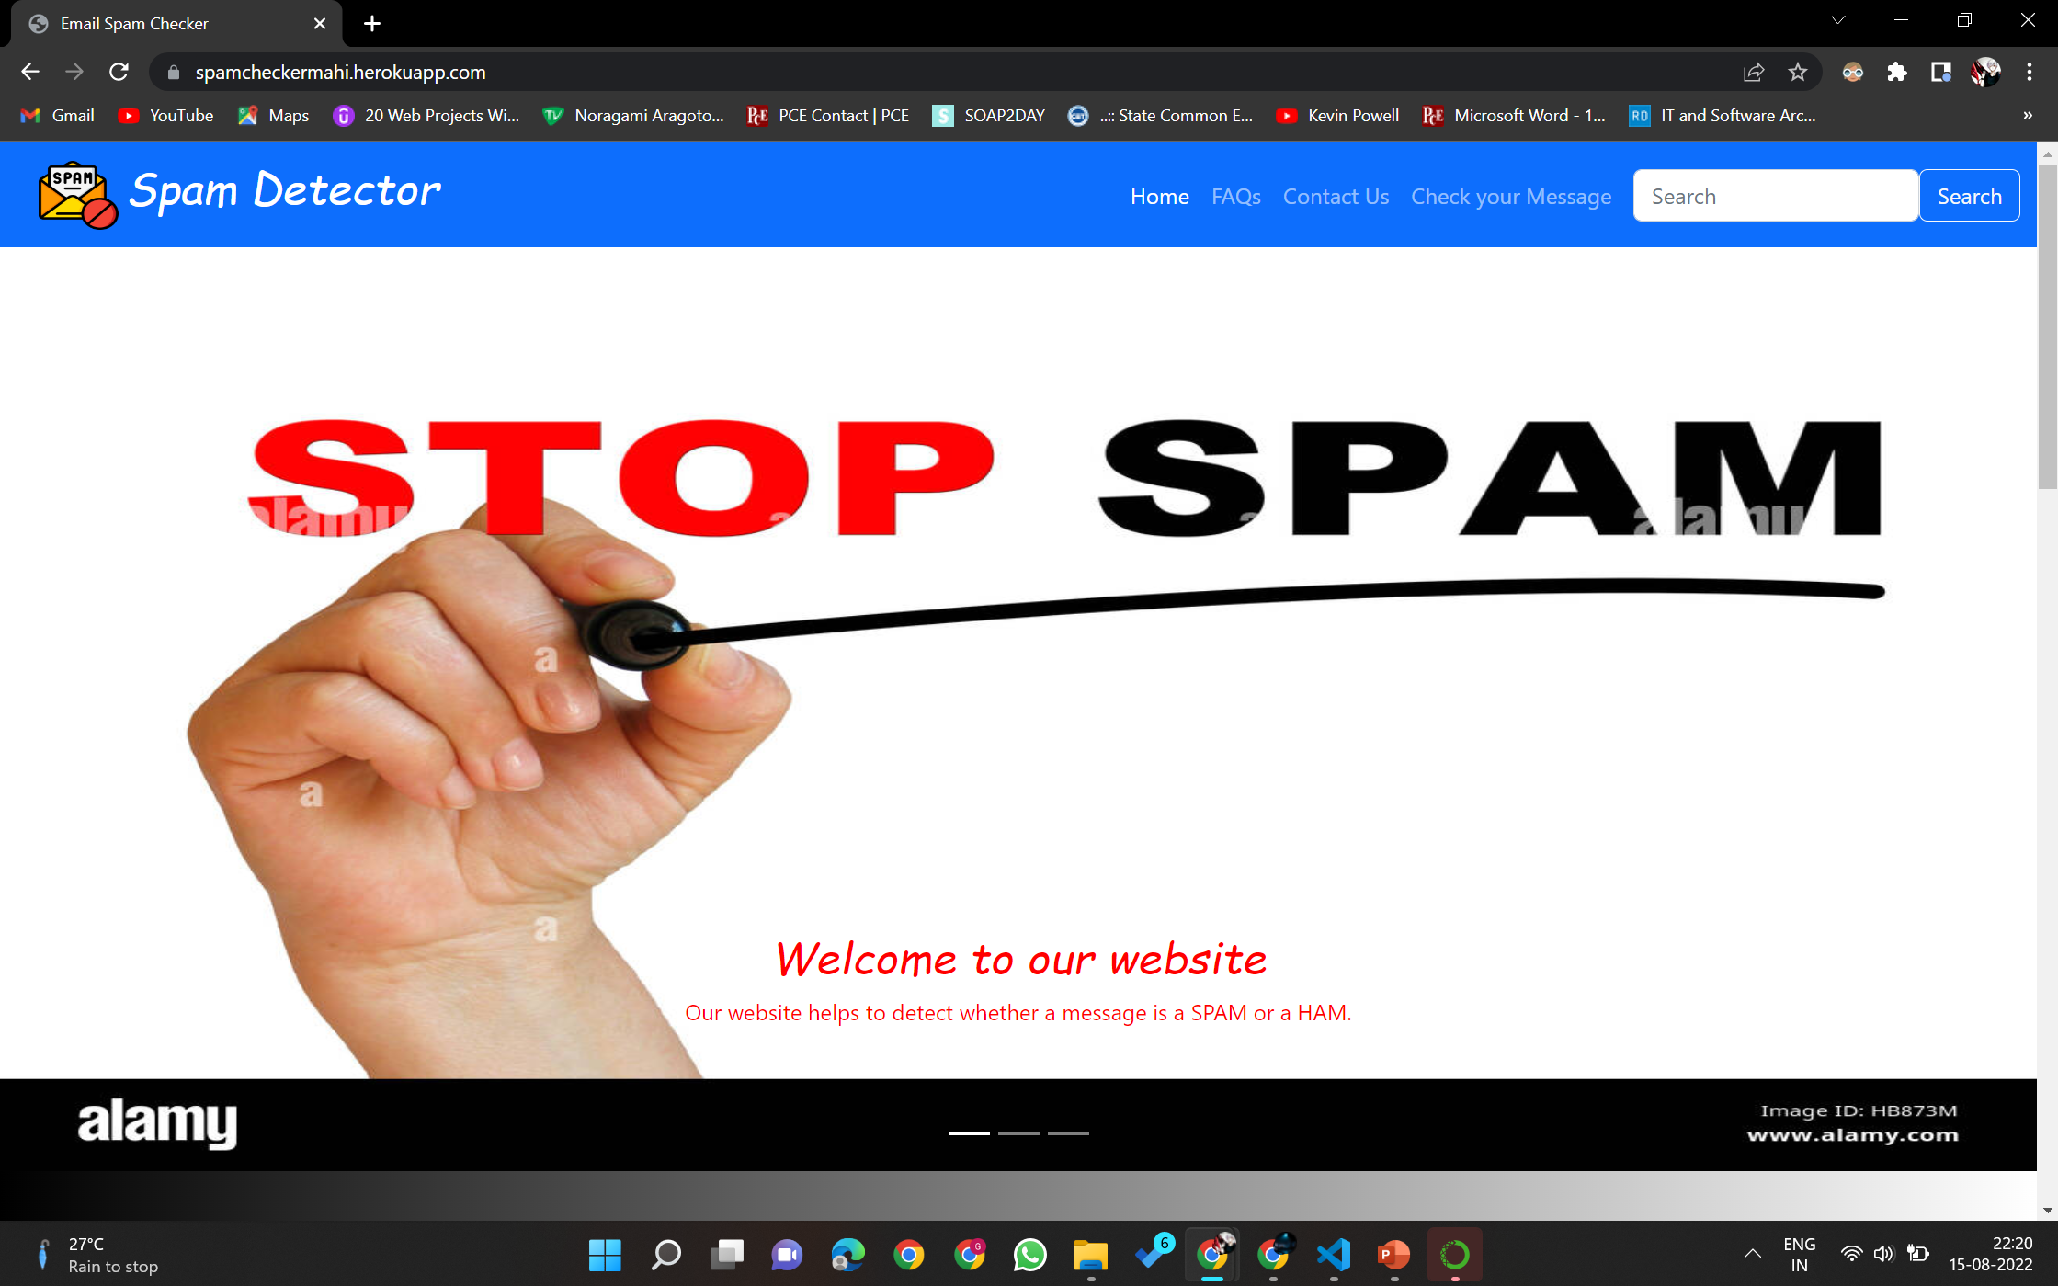
Website output :

Slide 19
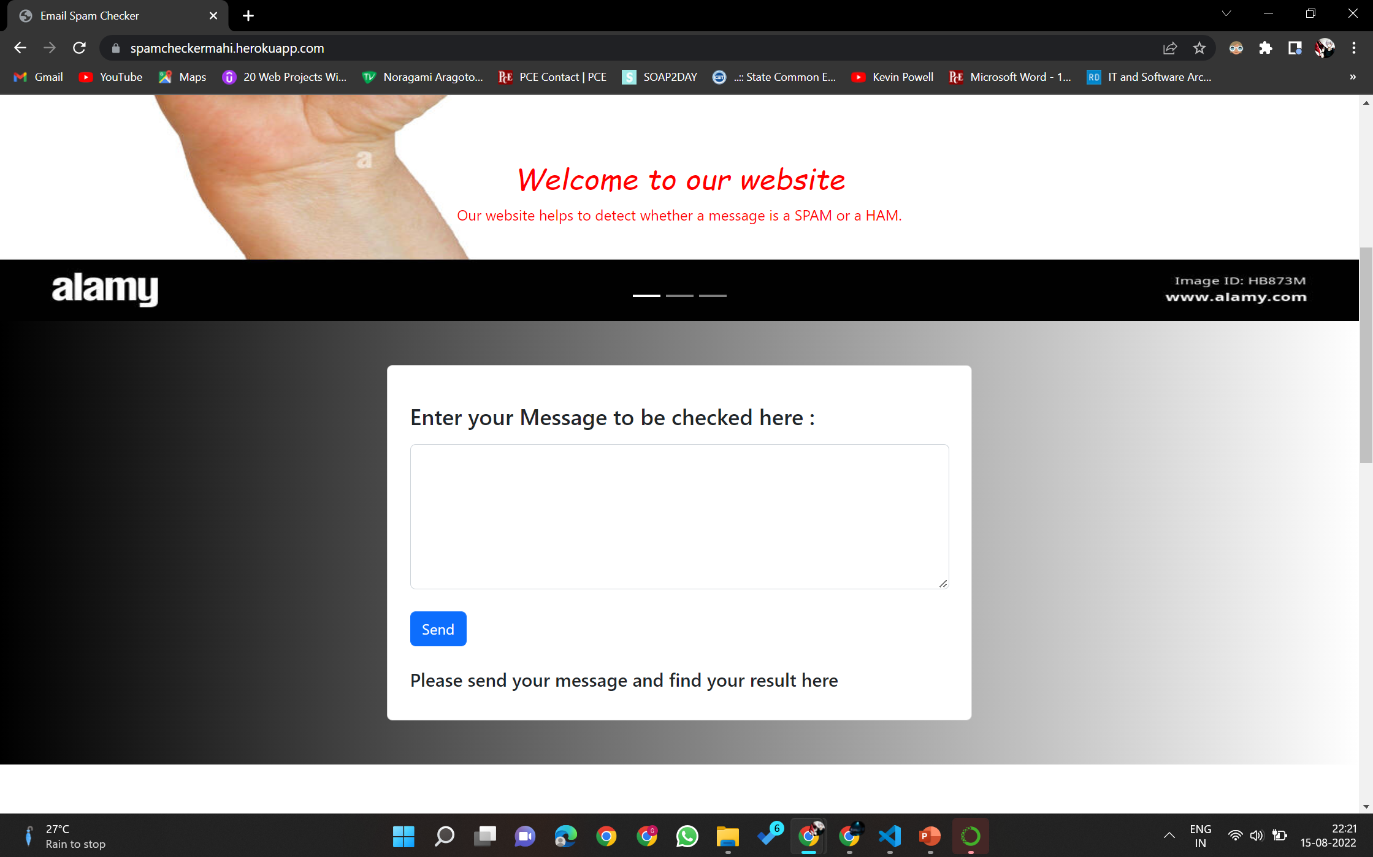
Website output :

Slide 20
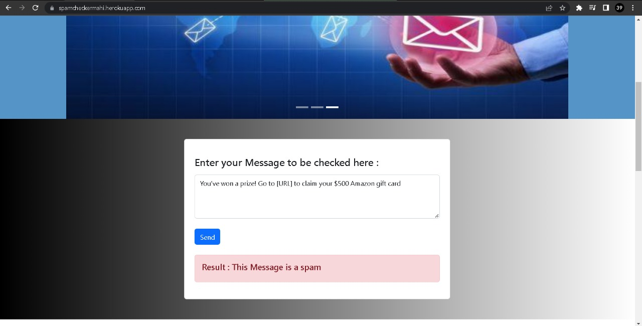
Website Working:

Slide 21
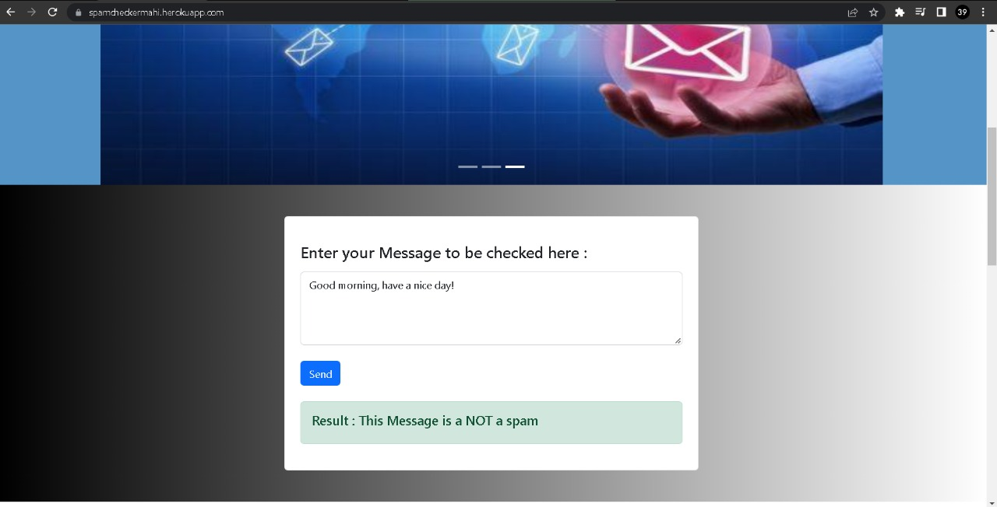
Website Working:

Slide 22
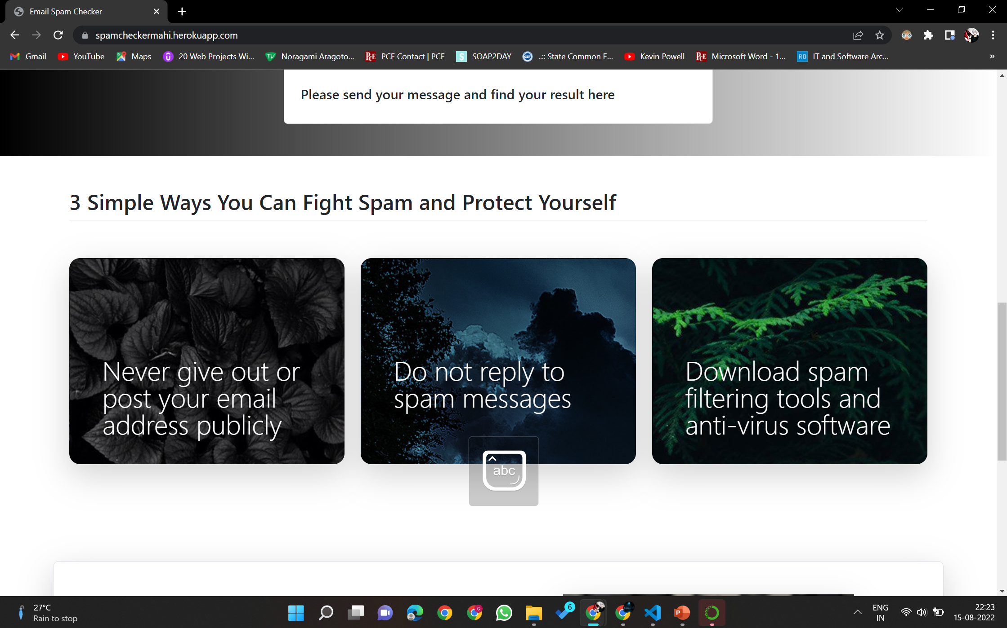
Website output :

Slide 23
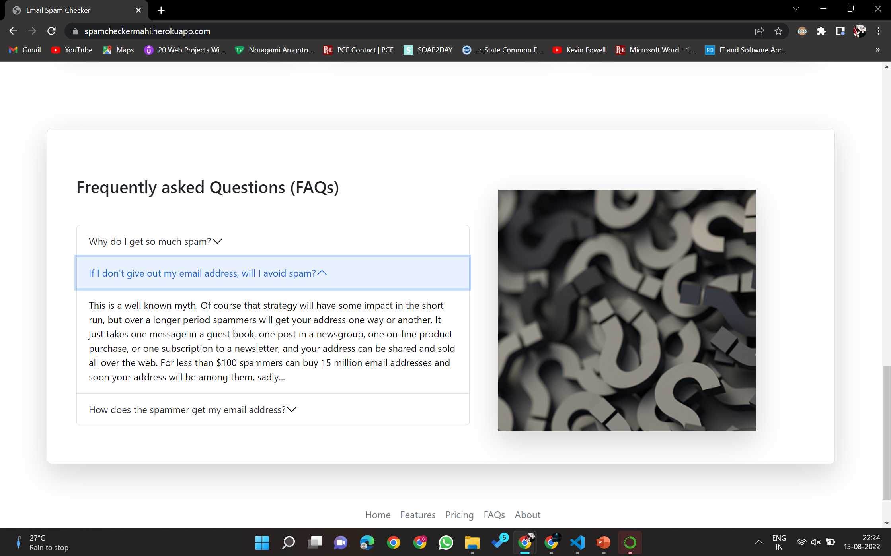
Website output :

Slide 24
CONCLUSION
OUR IMPLEMENTATION ON SPAM/HAM EMAIL CLASSIFICATION USING NLP HAS BEEN DESIGNED AND THE OUTCOMES OF OUR ML MODEL IS AS PER OUR EXPECTATIONS.

Slide 25


